Slide 1
ETL Testing Training
By,
Edureka

Slide 2
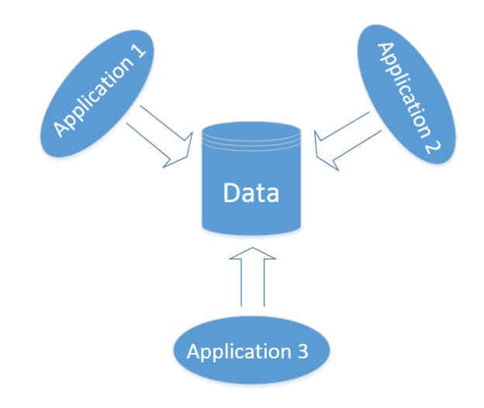
Introduction to Data Centric Applications
Data-centric refers to an approach or methodology that places the focus on data as the primary asset of an organization or system.
In this approach, data is treated as a valuable resource that must be managed, protected, and optimized to support the goals and objectives of the organization.
Data-centric systems are designed to facilitate the collection, storage, processing, and analysis of data.
These systems are typically characterized by a centralized data repository or data warehouse, which serves as a single source of truth for all data-related activities.

Slide 3
Introduction to Data Centric Applications cont…
Data-centric systems can be found in a wide range of applications and industries, including finance, healthcare, retail, and manufacturing.
In each of these industries, data is critical to the success of the organization and is used to make informed business decisions, improve operational efficiency, and gain a competitive advantage.
Data-centric approaches are becoming increasingly important in today's digital age, where organizations are generating vast amounts of data from a variety of sources.
By adopting a data-centric approach, organizations can ensure that their data is accurate, secure, and readily accessible, enabling them to make more informed decisions and achieve better business outcomes.

Slide 4
Data Centric Testing
Data-centric testing is a type of software testing that focuses on the accuracy, completeness, and consistency of data used by an application or system.
In this approach, testing is performed on the data that is being input into the system and the output produced by the system in response to that data.
The primary objective of data-centric testing is to identify defects related to the handling of data, such as incorrect calculations, data truncation or data loss, invalid data types or formats, missing data, and inconsistent data.
This type of testing is particularly important for systems that involve complex data processing, such as financial, healthcare, or scientific applications.

Slide 5
Data-Centric Testing Techniques
Data validation:
This involves verifying that the data entered into the system is valid and conforms to the expected format and data type.
Data integrity testing:
This involves testing the accuracy and completeness of data stored in the system.
Data transformation testing:
This involves testing the accuracy of data transformations performed by the system, such as data conversion, aggregation, or filtering.
Data comparison testing:
This involves comparing the output produced by the system against expected results based on the input data.

Slide 6
Data Warehousing and Business Intelligence
Business intelligence (BI) and Data Warehousing(DWH) are two closely related concepts that are used to help organizations better manage and analyze their data.

Slide 7
Business Intelligence (BI)
BI refers to the set of tools, technologies, and practices that organizations use to collect, integrate, analyze, and present data in a way that supports decision-making.
The goal of BI is to transform data into actionable insights that can be used to drive business growth and improve operational efficiency.

Slide 8
Data Warehousing (DWH)
Data warehousing, on the other hand, refers to the process of collecting, storing, and organizing large amounts of data from various sources in a centralized repository.
The data warehouse is designed to support complex queries and analysis, allowing organizations to gain a comprehensive view of their operations and make informed decisions.

Slide 9
DWH and BI
In many cases, data warehousing is a critical component of BI, as it provides the foundation for data analysis and reporting. By consolidating data from various sources into a single repository, organizations can gain a holistic view of their operations and use BI tools to extract insights and make data-driven decisions.
Together, BI and data warehousing enable organizations to gain deeper insights into their operations, improve their decision-making capabilities, and achieve better business outcomes. By leveraging these technologies, organizations can better understand their customers, optimize their operations, and drive growth and profitability.

Slide 10
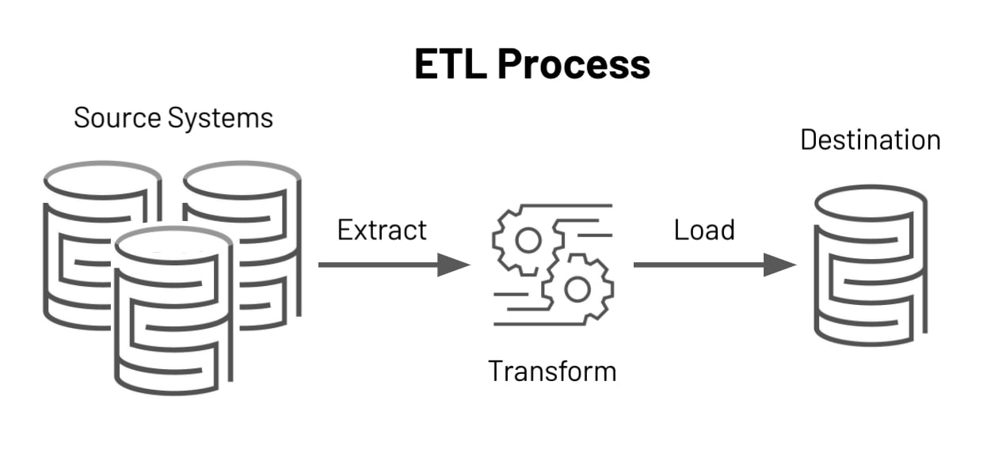
ETL Process
ETL stands for Extract, Transform, and Load, and it is a process used to extract data from various sources, transform it into a format that is appropriate for analysis, and load it into a target database or data warehouse.

Slide 11
ETL Process cont..
The ETL process typically involves the following steps:
Extraction:
In this step, data is extracted from one or more source systems, which can include databases, files, APIs, and other sources. The data is usually extracted based on a set of predefined rules or criteria.
Transformation:
The extracted data is then transformed into a format that is consistent with the target database or data warehouse. This can involve cleaning and standardizing the data, applying business rules, and converting data types.
Loading:
Finally, the transformed data is loaded into the target database or data warehouse. This involves mapping the data to the appropriate tables and columns and performing any necessary validation checks.

Slide 12
ETL Process cont..
The ETL process is critical for data warehousing and business intelligence applications, as it allows organizations to consolidate data from multiple sources into a single repository for analysis and reporting.
The process can be complex, and it requires a high level of expertise to design, develop, and maintain an ETL system effectively.
ETL tools are often used to automate the process and reduce the risk of errors and inconsistencies.

Slide 13
ETL Testing
ETL testing is a type of software testing that focuses on verifying the accuracy, completeness, and reliability of the ETL process.
The goal of ETL testing is to ensure that data is extracted from source systems correctly, transformed to the appropriate format, and loaded into the target database or data warehouse without any errors or inconsistencies.

Slide 14
ETL Testing cont…
ETL testing involves a series of tests that are designed to validate the various stages of the ETL process, including:
Data validation:
This involves verifying that the data extracted from source systems is accurate and complete.
Data transformation:
This involves testing the accuracy of data transformations performed during the ETL process, such as data conversions, aggregations, or filtering.
Data reconciliation:
This involves comparing the data in the source and target systems to ensure that the data has been loaded correctly and that there are no discrepancies.
Performance testing:
This involves testing the performance of the ETL process, including data throughput, processing speed, and scalability.
Error handling:
This involves testing the ability of the ETL system to handle errors and exceptions, such as missing or invalid data.

Slide 15
ETL Testing cont…
ETL testing is critical to ensuring the quality and reliability of the data warehousing and business intelligence applications.
ETL testing can help identify and resolve data quality issues early in the development cycle, reducing the risk of data inconsistencies and errors in the production environment.
ETL testing is often automated using specialized tools, which can help improve the efficiency and effectiveness of the testing process.

Slide 16
Database Testing
Database testing is a process used to verify the accuracy, completeness, and reliability of the data stored in a database.
The purpose of database testing is to ensure that the data in the database is consistent, accurate, and can be retrieved and manipulated as expected.

Slide 17
Database Testing cont…
Database testing typically involves a series of tests that are designed to verify the following aspects of the database:
Data integrity:
This involves verifying that the data in the database is accurate, complete, and consistent. Data integrity testing involves checking for duplicate data, missing data, incorrect data, and data that violates business rules.
Data validity:
This involves verifying that the data in the database is valid, meaning that it conforms to the data types and constraints defined in the database schema. Data validity testing involves checking for data types, data ranges, null values, and other constraints.
Data manipulation:
This involves verifying that the data in the database can be retrieved, updated, and deleted as expected. Data manipulation testing involves testing SQL queries, stored procedures, triggers, and other database objects.
Performance:
This involves testing the performance of the database, including its response time, scalability, and concurrency. Performance testing involves running queries and transactions under different load conditions to determine the maximum capacity of the database.
Security:
This involves testing the security of the database, including access control, authentication, and authorization. Security testing involves checking for vulnerabilities, such as SQL injection, and verifying that the database is compliant with security standards.

Slide 18
Database Testing cont…
Database testing is critical to ensuring the quality and reliability of the data stored in a database.
It can help identify and resolve data quality issues early in the development cycle, reducing the risk of data inconsistencies and errors in the production environment.
Database testing can be performed manually or using automated tools, which can help improve the efficiency and effectiveness of the testing process.

Slide 19
Types of Database Testing
There are several types of database testing that can be performed to ensure the quality and reliability of the data stored in a database. Some of the most common types of database testing include:
Functional testing:
Data integrity testing
Performance testing
Security testing
Usability testing
Regression testing
Disaster recovery testing

Slide 20
Functional testing:
This involves testing the functionality of the database, including its ability to store, retrieve, and manipulate data. Functional testing involves checking that the database meets the requirements specified in the functional specification.
Data integrity testing:
This involves testing the accuracy, completeness, and consistency of the data stored in the database. Data integrity testing involves verifying that the data is correct and consistent with business rules and constraints.
Performance testing:
This involves testing the performance of the database, including its response time, scalability, and concurrency. Performance testing involves running queries and transactions under different load conditions to determine the maximum capacity of the database.

Slide 21
Security testing:
This involves testing the security of the database, including access control, authentication, and authorization. Security testing involves checking for vulnerabilities, such as SQL injection, and verifying that the database is compliant with security standards.
Usability testing:
This involves testing the usability of the database, including its user interface and user experience. Usability testing involves verifying that the database is easy to use, intuitive, and efficient.
Regression testing:
This involves testing the database after changes have been made to it, to ensure that the changes have not introduced any errors or issues. Regression testing involves running the same tests that were previously run on the database and comparing the results to detect any discrepancies.
Disaster recovery testing:
This involves testing the ability of the database to recover from disasters, such as hardware failures, network outages, or natural disasters. Disaster recovery testing involves simulating various disaster scenarios and verifying that the database can recover and resume normal operations.

